Slide 1
Pandas

Slide 2
What is Pandas?
Pandas is a Python library used for working with data sets.
It has functions for analyzing, cleaning, exploring, and manipulating data.
The name "Pandas" has a reference to both "Panel Data", and "Python Data Analysis" and was created by Wes McKinney in 2008.
Why Use Pandas?
Pandas allows us to analyze big data and make conclusions based on statistical theories.
Pandas can clean messy data sets, and make them readable and relevant.
Relevant data is very important in data science.
What Can Pandas Do?
Is there a correlation between two or more columns?
What is average value?
Max value?
Min value?
Pandas are also able to delete rows that are not relevant, or contains wrong values, like empty or NULL values. This is called cleaning the data.
Import Pandas
Once Pandas is installed, import it in your applications by adding the import keyword:
import pandas

Slide 3
Example
import pandas as pd
mydataset = {
'cars': ["BMW", "Volvo", "Ford"],
'passings': [3, 7, 2]
}
myvar = pd.DataFrame(mydataset)
print(myvar)
Pandas Series
What is a Series?
A Pandas Series is like a column in a table.
It is a one-dimensional array holding data of any type.
Example
Create a simple Pandas Series from a list:
import pandas as pd a = [1, 7, 2] myvar = pd.Series(a) print(myvar)

Slide 4
Create Labels
With the index argument, you can name your own labels.
Example
Create your own labels:
import pandas as pd a = [1, 7, 2] myvar = pd.Series(a, index = ["x", "y", "z"]) print(myvar)
x 1
y 7
z 2
dtype: int64
Without label:
print(myvar[0])
With Label:
print(myvar["y"])

Slide 5
Key/Value Objects as Series
You can also use a key/value object, like a dictionary, when creating a Series.
Example
Create a simple Pandas Series from a dictionary:
import pandas as pd calories = {"day1": 420, "day2": 380, "day3": 390} myvar = pd.Series(calories) print(myvar)
print(myvar[0])

Slide 6
DataFrames
Data sets in Pandas are usually multi-dimensional tables, called DataFrames.
Series is like a column, a DataFrame is the whole table.
Example
Create a DataFrame from two Series:
import pandas as pd data = { "calories": [420, 380, 390], "duration": [50, 40, 45] } myvar = pd.DataFrame(data) print(myvar)

Slide 7
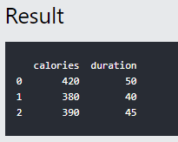
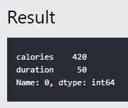
import pandas as pd data = { "calories": [420, 380, 390], "duration": [50, 40, 45] } #load data into a DataFrame object: df = pd.DataFrame(data) print(df)
Locate Row
As you can see from the result above, the DataFrame is like a table with rows and columns.
Pandas use the loc attribute to return one or more specified row(s)
Example
Return row 0:
#refer to the row index: print(df.loc[0])

Slide 8
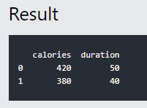
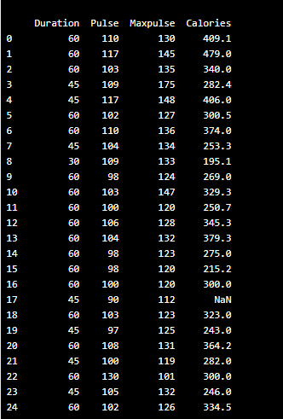
Example
Return row 0 and 1:
#use a list of indexes: print(df.loc[[0, 1]])
Note: When using [], the result is a Pandas DataFrame.
Read CSV
A simple way to store big data sets is to use CSV files (comma separated files).
CSV files contains plain text and is a well know format that can be read by everyone including Pandas.
Example
Load the CSV into a DataFrame:
import pandas as pd df = pd.read_csv('data.csv') print(df.to_string())
Note: use to_string() to print the entire DataFrame.

Slide 9
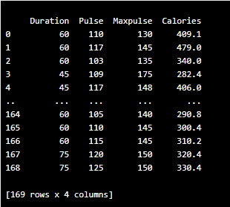
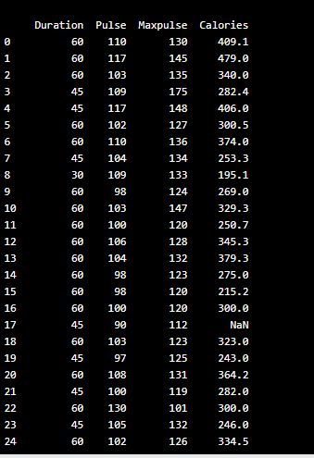
If you have a large DataFrame with many rows, Pandas will only return the first 5 rows,
and the last 5 rows:
Example
Print the DataFrame without the to_string() method:
import pandas as pd df = pd.read_csv('data.csv') print(df)
import pandas as pd
pd.options.display.max_rows = 9999
df = pd.read_csv('data.csv')
print(df)

Slide 10
Viewing the Data
One of the most used method for getting a quick overview of the DataFrame, is the head()
method.
The head() method returns the headers and a specified number of rows, starting from the top.
Example
Get a quick overview by printing the first 10 rows of the DataFrame:
import pandas as pd df = pd.read_csv('data.csv') print(df.head(10))
Note: if the number of rows is not specified, the head() method will return the top 5 rows.
There is also a tail() method for viewing the last rows of the DataFrame.
The tail() method returns the headers and a specified number of rows, starting from the bottom.
Example
Print the last 5 rows of the DataFrame:
print(df.tail())

Slide 11
Info About the Data
The DataFrames object has a method called info(), that gives you more information
about the data set.
Example
Print information about the data:
print(df.info())
Data Cleaning
Data cleaning means fixing bad data in your data set.
Bad data could be:
Empty cells
Data in wrong format
Wrong data
Duplicates

Slide 12
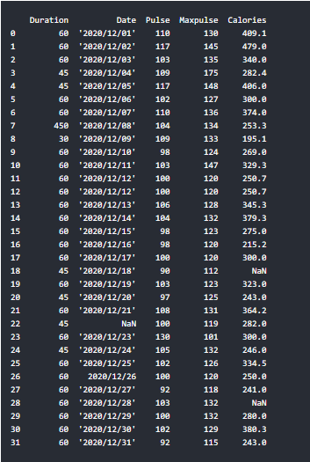
Sample Data
The data set contains some empty cells ("Date" in row 22, and "Calories" in row 18 and 28).
The data set contains wrong format ("Date" in row 26).
The data set contains wrong data ("Duration" in row 7).
The data set contains duplicates (row 11 and 12).

Slide 13
Cleaning Empty Cells
Remove Rows
Example
Return a new Data Frame with no empty cells:
import pandas as pd df = pd.read_csv('data.csv') new_df = df.dropna() print(new_df.to_string())
Note: By default, the dropna() method returns a new DataFrame, and will not change the original.
To change the original DataFrame, use the inplace = True argument:
Example
Remove all rows with NULL values:
import pandas as pd df = pd.read_csv('data.csv') df.dropna(inplace = True) print(df.to_string())

Slide 14
Replace Empty Values
Another way of dealing with empty cells is to insert a new value instead.
The fillna() method allows us to replace empty cells with a value:
Example
Replace NULL values with the number 130:
import pandas as pd df = pd.read_csv('data.csv') df.fillna(130, inplace = True)
Replace Only For Specified Columns
The example above replaces all empty cells in the whole Data Frame.
To only replace empty values for one column, specify the column name for the DataFrame:
Example
Replace NULL values in the "Calories" columns with the number 130:
import pandas as pd df = pd.read_csv('data.csv') df["Calories"].fillna(130, inplace = True)

Slide 15
Cleaning Data of Wrong Format
Example
Convert to date:
import pandas as pd df = pd.read_csv('data.csv') df['Date'] = pd.to_datetime(df['Date']) print(df.to_string())
Example
Remove rows with a NULL value in the "Date" column:
df.dropna(subset=['Date'], inplace = True)

Slide 16
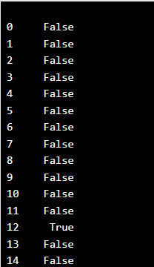
Fixing Wrong Data
Example
import pandas as pd
df = pd.read_csv('data.csv')
df.loc[7,'Duration'] = 45
print(df.to_string())
for x in df.index: if df.loc[x, "Duration"] > 120: df.loc[x, "Duration"] = 120
Removing Duplicates
import pandas as pd
df = pd.read_csv('data.csv')
print(df.duplicated())
import pandas as pd
df = pd.read_csv('data.csv')
df.drop_duplicates(inplace = True)
print(df.to_string())

Slide 17
NumPy

Slide 18
What is NumPy?
NumPy is a Python library used for working with arrays.
It also has functions for working in domain of linear algebra, fourier transform, and matrices.
NumPy was created in 2005 by Travis Oliphant. It is an open source project and you can use it freely.
NumPy stands for Numerical Python.
Why Use NumPy?
In Python we have lists that serve the purpose of arrays, but they are slow to process.
NumPy aims to provide an array object that is up to 50x faster than traditional Python lists.
The array object in NumPy is called ndarray, it provides a lot of supporting functions
that make working with ndarray very easy.
Arrays are very frequently used in data science, where speed and resources are very important.

Slide 19
NumPy ndarray Object
NumPy is used to work with arrays. The array object in NumPy is called ndarray.
We can create a NumPy ndarray object by using the array() function.
Example
import numpy as np arr = np.array([1, 2, 3, 4, 5]) print(arr) print(type(arr))
Example
import numpy as np
arr = np.array((1, 2, 3, 4, 5))
print(arr)
[1 2 3 4 5]

Slide 20
1-D Arrays
An array that has 0-D arrays as its elements is called uni-dimensional or 1-D array.
These are the most common and basic arrays.
Example
Create a 1-D array containing the values 1,2,3,4,5:
import numpy as np arr = np.array([1, 2, 3, 4, 5]) print(arr)
2-D Arrays
An array that has 1-D arrays as its elements is called a 2-D array.
These are often used to represent matrix or 2nd order tensors.
Example
Create a 2-D array containing two arrays with the values 1,2,3 and 4,5,6:
import numpy as np arr = np.array([[1, 2, 3], [4, 5, 6]]) print(arr)

Slide 21
3-D arrays
An array that has 2-D arrays (matrices) as its elements is called 3-D array.
Example
import numpy as np arr = np.array([[[1, 2, 3], [4, 5, 6]], [[1, 2, 3], [4, 5, 6]]]) print(arr)
import numpy as np
a = np.array(42)
b = np.array([1, 2, 3, 4, 5])
c = np.array([[1, 2, 3], [4, 5, 6]])
d = np.array([[[1, 2, 3], [4, 5, 6]], [[1, 2, 3], [4, 5, 6]]])
print(a.ndim)
print(b.ndim)
print(c.ndim)
print(d.ndim)

Slide 22
import numpy as np arr = np.array([1, 2, 3, 4]) print(arr[0])
import numpy as np arr = np.array([1, 2, 3, 4]) print(arr[1])
import numpy as np arr = np.array([1, 2, 3, 4]) print(arr[2] + arr[3])
import numpy as np arr = np.array([[1,2,3,4,5], [6,7,8,9,10]]) print('2nd element on 1st row: ', arr[0, 1])
import numpy as np arr = np.array([[1,2,3,4,5], [6,7,8,9,10]]) print('5th element on 2nd row: ', arr[1, 4])
import numpy as np arr = np.array([[[1, 2, 3], [4, 5, 6]], [[7, 8, 9], [10, 11, 12]]]) print(arr[0, 1, 2])

Slide 23
NumPy Searching Arrays
Search an array for a certain value, and return the indexes that get a match.
To search an array, use the where() method.
Example
Find the indexes where the value is 4:
import numpy as np arr = np.array([1, 2, 3, 4, 5, 4, 4]) x = np.where(arr == 4) print(x)
(array([3, 5, 6],)
import numpy as np arr = np.array([1, 2, 3, 4, 5, 6, 7, 8]) x = np.where(arr%2 == 0) print(x)

Slide 24
Example
Sort the array:
import numpy as np arr = np.array([3, 2, 0, 1]) print(np.sort(arr))

